Slide 1


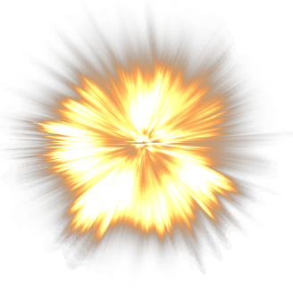
previous
next
17 | 20 | 45 | 57 | 62 | 120
-30
detonate
Gosho
-30

Slide 2
Leonidas
Xena The Princess Warrior
General Protos
Gorok
Bozat
Subotli
Kira
Zaler

